Slide 1

English Language: Transactional Writing
Review Writing Lesson 2

Slide 2

Learning Objective
To use the features of review writing in my work.
Success Criteria
To identify modal verbs and understand how they are used.
To understand how to use review-specific techniques in my work.
To create a review using my knowledge of review writing features.

Slide 3
Starter Task
modal verbs
Modal verbs are used before another verb to express how possible or necessary it is.
would
could
should
must
might
may
will
Draw a scale in your books with least certain at one end and most certain at the other.
Order the verbs in terms of strength, from least to most certain.
Extension
Explain how different modal verbs change the following sentence:
The film __________ appeal to a teenage audience.

Slide 4
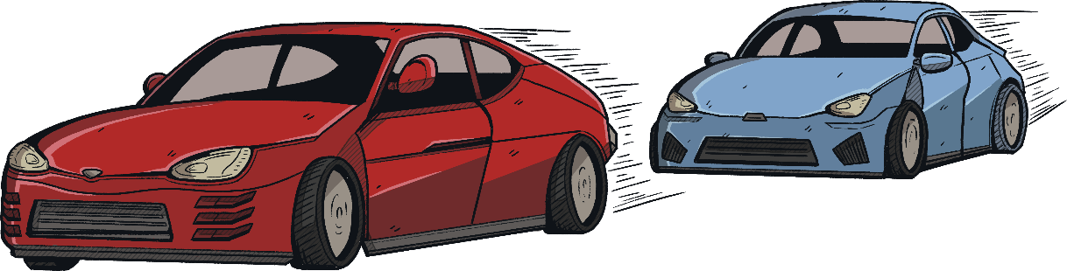
Modal Verbs
Read the example review below.
Can you identify the modal verbs being used?
The driving scenes are littered with ludicrous slow-motion pans and zooms when they should be a frenzy of fast, kinetic action. The races, which could have been exhilarating, are too often slowed down by this stop-start approach. Throw in poor CGI and over-the-top rap music and you have Revved and Ready. Some might consider cartoons more realistic!
All things considered, Revved and Ready should have challenged the Fast and Furious franchise for first place. It could still race, but it will never take the lead.

Slide 5
Fun Puns!
Film reviews have an entertaining tone that makes them fun and interesting to read.
For example:
You’ll have an abba-solutely fantastic time watching Mamma Mia!
Toy Story will take you to infinity and beyond!
Fast and Furious will quickly make your blood boil!
Your turn: Create puns for some of your favourite films and be ready to share them!

Slide 6
Meaningful Metaphors!
Metaphors can be a sophisticated way to let the reader know what the review is about!
For example:
Monsters Inc. will consume you in seconds!
It is a rollercoaster ride of emotions.
The superheroes exploded on to our screens.
This film is a sandy beach on a beautiful day.
Your turn: Create metaphors you could use for some of your favourite films and be ready to share them!

Slide 7
Entertaining Extras
Embedded clauses can be used to add extra detail to your sentences about the films.
For example:
The director, responsible for Jaws and Jurassic Park, has released another hit.
Ryan Reynolds, who has previously starred in comedies, brings his humour to Deadpool.
The previous instalment, which came out last summer, took cinemas by storm.
Your turn: Add more detail to one of the sentences below with an embedded clause. Don’t forget your commas!
Gnomeo and Juliet is a modern day love story.
Leonardo DiCaprio stars as the hero of the film.
Audiences have been disappointed with the film.

Slide 8
Apply Your Knowledge!
Write your own review about a film you have seen recently that you enjoyed!
Make sure you use your success criteria list to help you!
Introduction:
Overview
Reception
What are critics saying?
Factual detail about director/ earnings and other film features
Plot:
Rough story line (don’t give the ending away)
Key events
Rhetorical questions to build suspense
Paragraph length should be varied for effect.
1.5 pages minimum!
Pack a punch with AFOREST!
Plot 2:
Key characters (hero, villain, love interest etc.)
Show off your AFOREST skills: list of three, alliteration and exaggeration are key!
Overall opinion:
Avoid ‘I’ (‘Families will love this action-packed adventure!’)
Summarise using outstanding noun phrases
Character/actor performance:
The good
The bad
Award nominations etc.

Slide 9
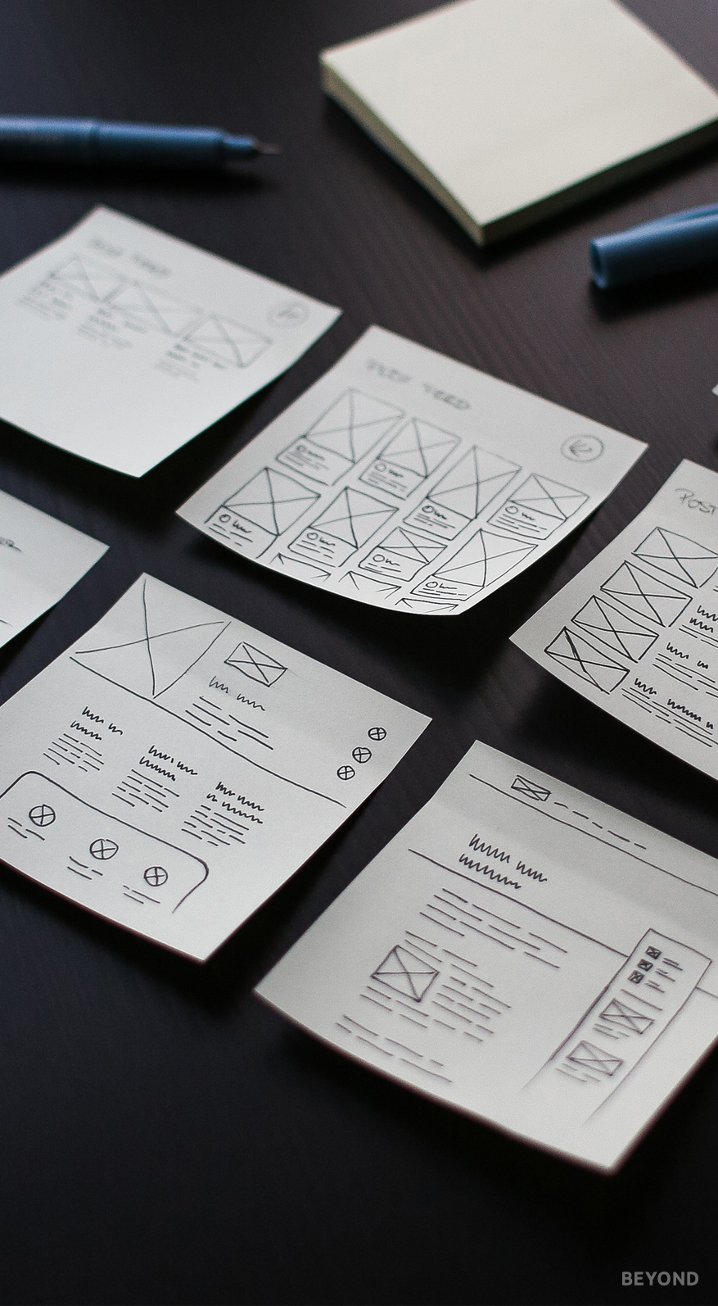
Checkpoint: Peer Assessment
Swap your work with someone sitting near to you or next to you.
Highlight and label any review writing features you can see being used.
Add one target for them to make their work even better.
Rapid Response!
Address your target straight away to make rapid progress!

Slide 10

End Point: Self Assessment
Use your Review Writing Knowledge Organiser to check your work.
Highlight any features from the Knowledge Organiser that you have used in your own work.

Slide 11


